Slide 1
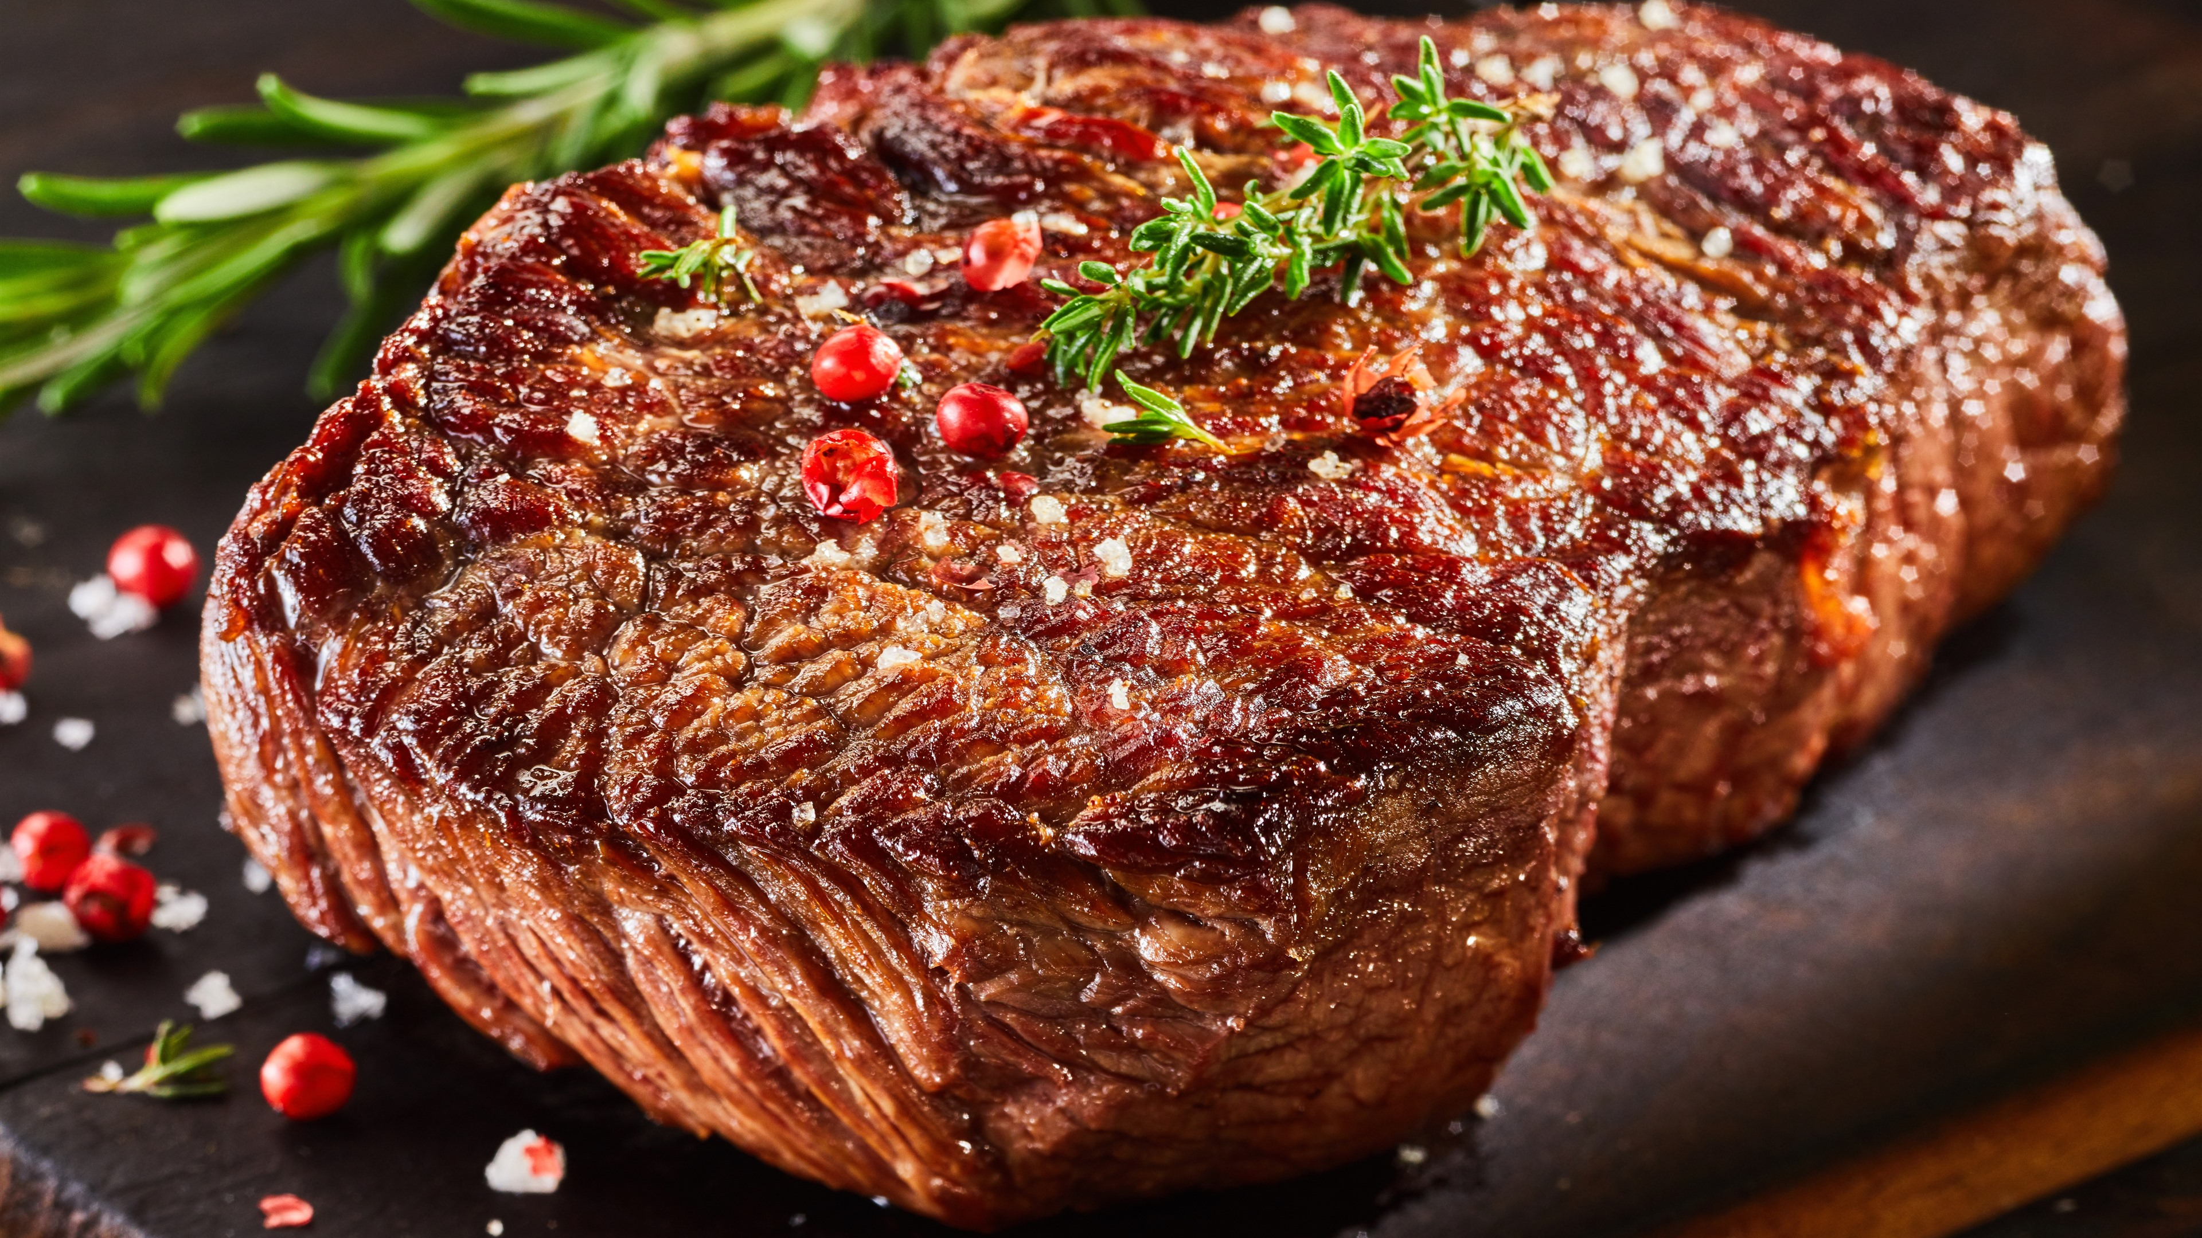
Meat Consumption: Reduce or Continue
Dheeraj
Notes:
RLS(various stakeholders, opinions)-AOK-Big ideas-Knowledge framework
Analysis on how knowledge is learnt, communicated, verified

Slide 2
Process
Part 1:
Real-Life Situation (RLS)
Part 2:
1st order subject-specific Knowledge Questions (KQ)
Part 3:
2nd order KQ for the RLS (with the ways of knowing (AOK))
Part 4:
Conclusion
Part 5:
Other application in the conclusion linking to the analysis

Slide 3
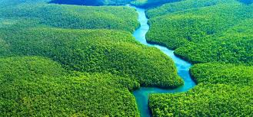
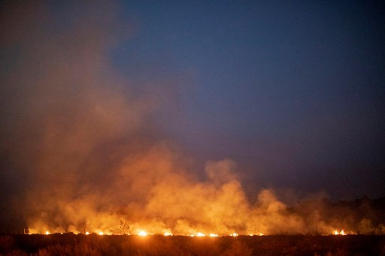
Real-Life Situation (RLS)
Why meat consumption is linked to the Amazon fires?
Theme: Changes in meat consumption
Date: August 2019
Location: Amazon rainforest in Brazil
Summary:
The international debate on whether meat consumption should be the main cause of the ongoing Amazon forest fires in Brazil
Stakeholders investigated: Farmers, indigenous tribes, consumers, G7 countries, the Brazilian president and the non-governmental organisations(NGOs)
Notes:
Limitations of our knowledge tools:
Perception(awareness through our five senses)
Three views on the relationship between perception and reality(Phenomenalism, common-sense and scientific realism)
How heavily can we rely on them? What limitations are we faced with?
Language
Reason
Emotion

Slide 4
Opinions on the stakeholders in the RLS
Farmers
Consumers
G7 countries
Slash-and-burn method to create pasture land to grow agriculture.
The farmers think that cutting down the trees is a long process and they started a forest fire to earn income faster. These actions were done for their living. Forest fires is seen as something important and the right thing for them.
Meat such as beef and pork is a staple for these chinese consumers. Since it is a staple, they view meat as something important and therefore view the forest fire with little regard as they are not responsible for it.
They understand the importance of protecting environment as it leads to unsustainable deforestation of the forest for livestock, agriculture etc.
It must be contained to further reduce worldwide impact and help control the planet’s climate.

Slide 5
Brazilian president
Indigenous tribes
Mr Jair has also deployed several troops to combat the forest fires.
He supports the deforestation and forest fires as he believes it will create infrastructure and jobs for his people. He views the economy as a priority instead of the environment despite the recent climate change problems and ignores the 2015 Paris climate change agreement also ignores the importance of Amazon rainforest for the world.
Mura tribe:
  Saddened by the disappearance of the forest due to the vast infrastructural development and climate change.
  Worried about the lives of the future generation, such as the children and the grandchildren, who may find it difficult to live in the forest peacefully if deforestation of the Amazon continues.
  The Mura tribe value the forest and does not support deforestation and forest fires as the Amazon Forest is their home, source of food, important for their existence and control of climate change. Its existence is important for their future generation too.

Slide 6
1st-order knowledge questions
Why do the different stakeholders in the RLS interpret the situation on the Amazon fires differently?
Possible inferences
Different groups of people have a variety of moral principles and values. This means that they will have their own perceptions of what is right or wrong and thus, form their own judgements to explain their principles.
Is one of the stakeholders in the RLS given more importance than the other?
All are given equal importance, but the indigenous tribes are given the highest priority because the Amazon forest is their home.

Slide 7

Analysis on KQ:
On what basis do we decide what is right or wrong?
Notes:
There is no need to take side. It is what basis.

Slide 8
How will I
be “unlocking” this KQ?
AOKs explored:
Ethics
Indigenous knowledge system
Ways of knowing(WOKs) explored:
Reasoning
Emotion
Faith
Types of knowledge:
Personal knowledge Shared knowledge (when there is a common similarity between different types of personal knowledge)
Perspective approach

Slide 9
Answering the KQ...
Perspective 1: Ethical theories
Duty-based ethics that determine from the right and wrong, and occur during a person’s action
Even if the action is considered to be wrong, people still do it because their principles tell them that it is correct to do so.
The Deontological theories influence our decision making on what is right or wrong.
Dependent on the scale of the results of each action.
The scale of each positive or negative consequence determine how appropriate an action is
Utilitarianism- people maximizing their human welfare
Hedonism- maximising human pleasure
Different stakeholders have different moral value, thus, uphold different ethical principles
The consequentialist theories also influence our decision making on what is right or wrong

Slide 10
Decisions influenced by ethical theories | Details
G7 Countries | Deontological theory: Pledged US$20 million to aid Brazil in combating forest fires as they see it as the utmost important duty to protect and safeguard the environment, even if that means harming the relationship with Brazil. Moreover they understand the importance of the forest for other stakeholders as well and the action is right by the nature of it. Utilitarianism: maximise people’s welfare all over the world by containing the forest fires, in order to control the planet’s climate.
Farmers | Deontological theory: Slash-and-burn methods to create pasture land for agriculture and livestock. This could be a source for their living income for family and food for their family and others around the world. It is their duty to look after the family.

Slide 11
Decisions influenced by ethical theories | Details
Brazilian president Mr Jair Bolsonaro | Deontological theories: He views the economy as a priority instead of the environment as the forest fires will create jobs for his people despite the recent climate change problems Consequentialist theory and utilitarianism: He did his duty as a president by providing more jobs for his people, thus maximizing their welfare
Consumers | Hedonism: The demand for Brazilian meat and commodities, especially by Chinese consumers, would be able to satisfy their cravings and needs Consequentialist theory: Even if this means greater deforestation back in the Amazon, the consumers feel that they have little involvement with protecting the environment as they are not directly responsible for the forest fires.
Decisions influenced by ethical theories | Details
Brazilian president Mr Jair Bolsonaro | Deontological theories: He views the economy as a priority instead of the environment as the forest fires will create jobs for his people despite the recent climate change problems Consequentialist theory and utilitarianism: He did his duty as a president by providing more jobs for his people, thuis maximising their welfare
Consumers | Hedonism: The demand for Brazilian meat and commodities, especially by Chinese consumers, would be able to satisfy their cravings and needs utilitarianism: Even if this means greater deforestation back in the Amazon, the consumers feel that they have little involvement with protecting the environment as they are not directly responsible for the forest fires.
Indigenous tribes | Consequentialist theory and utilitarianism : Lives of the future generation of the Mura tribe will be affected as their existence and welfare are threatened by the forest fires. The forest provides them shelter and food for them.They want to protect the forest to maximise the welfare of their people and benefit the environment

Slide 12
Decisions influenced by ethical theories | Details
Indigenous tribes | Consequentialist theory and utilitarianism : Lives of the future generation of the Mura tribe will be affected as their existence and welfare are threatened by the forest fires. The forest provides them food and shelter . They want to protect the forest to maximise the welfare of their people and benefit the environment

Slide 13
Perspective 2: Indigenous knowledge system
Unique, traditional, local knowledge existing within and developed around the specific conditions of women and men indigenous to a particular geographic area
How is the knowledge acquired, communicated and passed down?
Folklore
Natural features such as land and sea
Speac
Why are some of their beliefs considered ethical to the tribes?
The tribe’s sense perception and history
Praxis(the established practice or custom of any group skills passed down to the younger generations))
Faith in the tribes’ beliefs, practices and customs
Notes:
Beliefs, practices, traditions, how they pass down knowledge, way of life, perception on Amazon Fires, how do they acquire knowledge, how they communicate their knowledge.

Slide 14
Additional information about Brazil’s tribes
They are a hybrid ethnicity involving influences from Indian and other Latin American ethnicities such as Peruvian
Location - Amazon rainforest and urban areas in Northern Brazil
Language - Initially Nheengatu(Amazonian tribal language), now Portuguese
Origin - Mura people are called “caboclo” a regional term used by locals in a despising manner, referred to as “impure”, “cultured” indian. But now, the positive impression is made by indians and “caboclo”.
Historical background - 17th century- river-based people
Practices/beliefs/traditions - Extractive(discovering natural resources) needed for agriculture, minery and livestock
Source - River and the Amazon forest

Slide 15
Conclusion
Key takeaways:
Knowledge can be interpreted by various stakeholders differently.
In the RLS:
Different stakeholders view each others’ actions as either right or wrong. They have different moral values and perspectives. These are governed by their own ethical principles that they uphold. Their upbringing and environment also affects the decision that they make. For example the mura tribe. They were brought up in a different environment and have different traditions and customs, thus, their approach to the issue is different to the other stakeholders such as the Brazilian president who has conflicting interests with the Mura tribe. To answer the knowledge question, On what basis do we decide what is right or wrong?, One’s background, moral values and immediate stance on the issue affects the decision that they make which might be right or wrong.

Slide 16
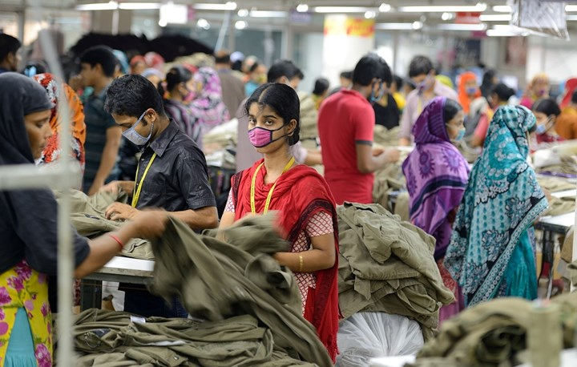
Other application to the analysis
Nike Sweatshop scandal
Nike, a company which has prided itself on work ethics, has been criticised by activists in neglecting the safety and well-being of its workers, especially in developing countries such as Bangladesh, India, Cambodia and Thailand. This included providing extremely low wages to workers, and restricting them access to clean water and toilet usage.
Examples:
1996: A twelve year old Pakistani boy was sewing a Nike soccer ball
2018: Clean Clothes Campaign reported that Nike still pays “poverty” wages to its workers
https://www.newidea.com.au/media/73484/bangladesh-textile-factory-2015.jpg?width=720&center=0.0,0.0

Slide 17
References
https://www.businessinsider.com/meat-consumption-linked-to-the-amazon-fires-2019-8?IR=T (1st RLS)
http://www.bbc.co.uk/ethics/introduction/duty_1.shtml
http://www.bbc.co.uk/ethics/introduction/consequentialism_1.shtml
https://www.theoryofknowledge.net/areas-of-knowledge/indigenous-knowledge-systems/(Indigenous knowledge systems)
https://www.theoryofknowledge.net/areas-of-knowledge/indigenous-knowledge-systems/how-is-knowledge-acquired-in-indigenous-societies/
https://pib.socioambiental.org/en/Povo:Mura
https://www.newidea.com.au/nike-sweatshops-the-truth-about-the-nike-factory-scandal(RLS In the conclusion)
https://www.channelnewsasia.com/news/world/brazil-slams-g7-aid-offer-as-amazon-fires-rage-11845194

Slide 18
References
https://www.cnbc.com/2019/09/24/brazils-president-attacks-amazon-rainforest-lies-thanks-trump.html
https://plato.stanford.edu/entries/consequentialism/
McMahan, Jeff. The Stone Reader : Modern Philosophy In 133 arguments. Ed. PETER CATAPANO and SIMON CRITCHLEY. Vol. first edition. New York: Liveright Publishing Corporation, 2016.
Cave, Peter. Ethics: A Beginner's Guide. Oneworld Publications, 2015.

